Slide 1
Boolean functions
ex 2.1 & 2.8
Author: Bejenaru Florin Dănuț

Slide 2
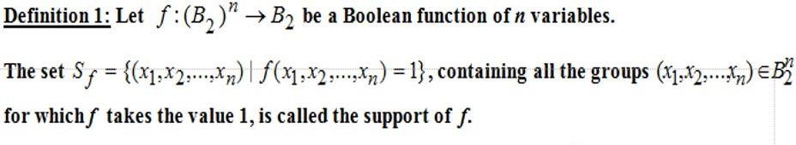

Monom – conjunction of variables
Minterm – monom that contains all n variables, it also takes value 1 for only one argument
Teoretical Results

Slide 3

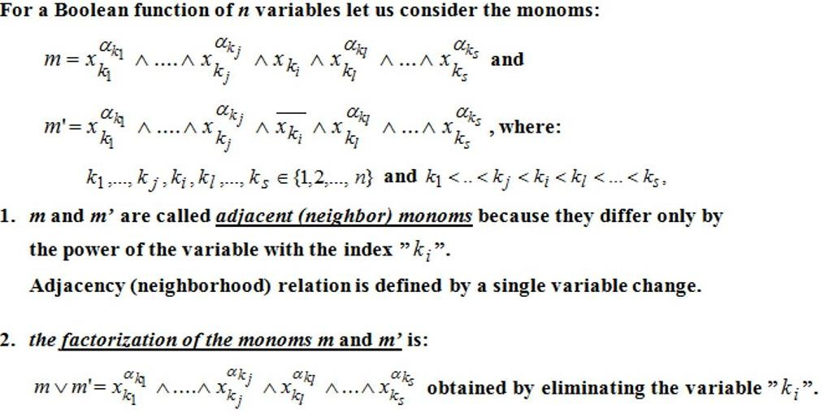
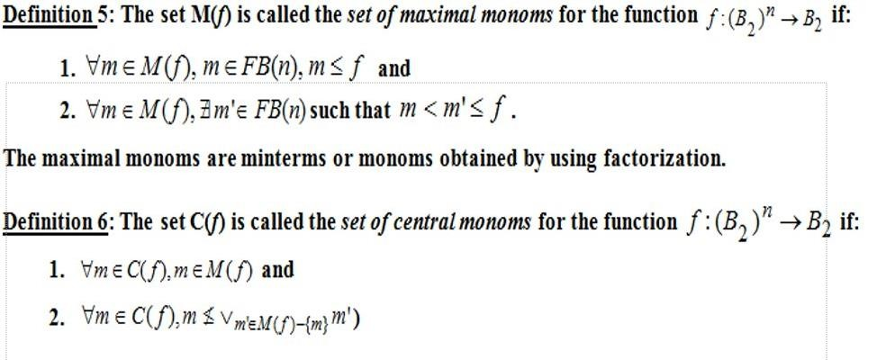

Slide 4
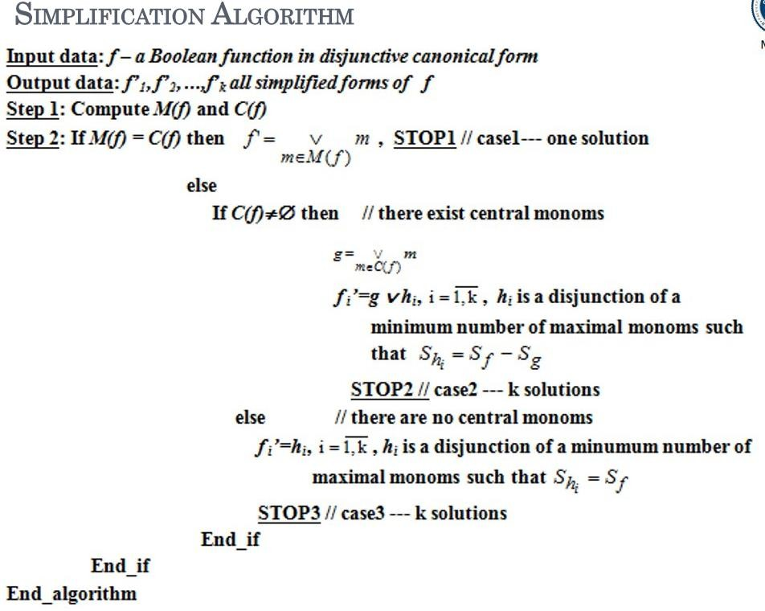
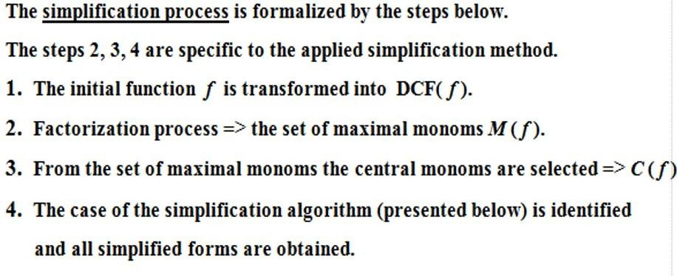

Slide 5
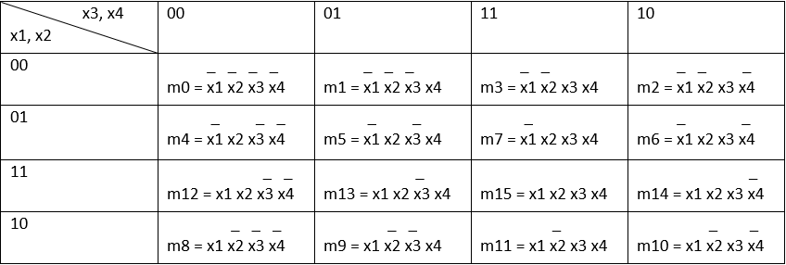
Solution
The label of a general K-Map with 4 variables

Slide 6
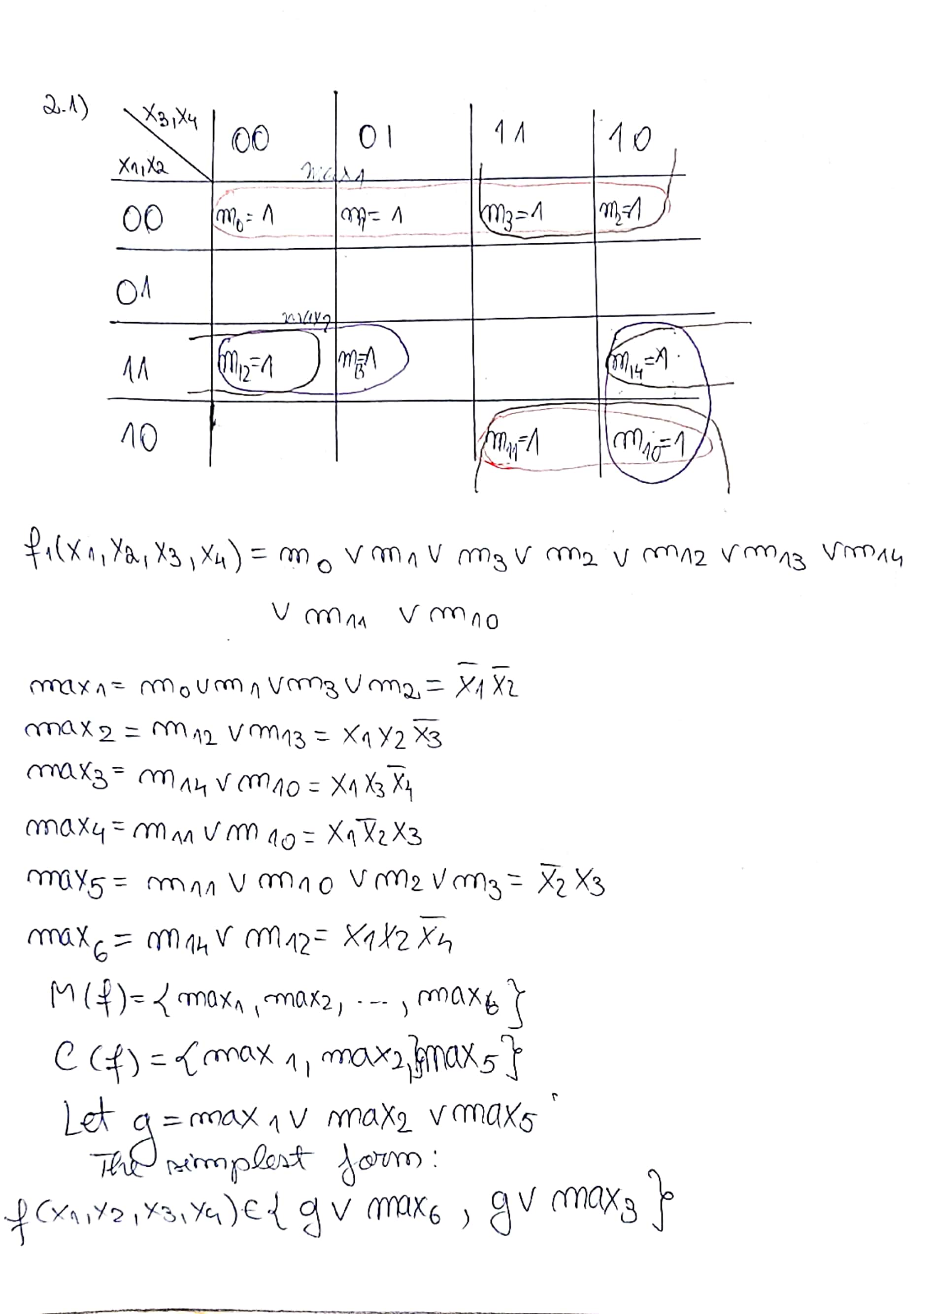

Slide 7
